Slide 1
Osteology of the lower limb
BY
DR OJEWALE A.O

Slide 2
OUTLINE
Intro’
Hip bone
Femur
Tibia
Fibula
Bones of the foot
Applied Anatomy

Slide 3
INTRODUCTION
Each lower limb contains 31 bones:
Hip bone, the bone of gluteal region (1).
Femur, the bone of thigh (1).
Patella or knee cap (1).
Tibia and fibula, the bones of leg (2).
Tarsal bones (7).
Metatarsals (5).
Phalanges (14).

Slide 4
ANATOMICAL POSITION AND SIDE DETERMINATION
The side of the hip bone is determined by holding it in such way that:
The acetabulum is directed laterally.
The obturator foramen lies below the acetabulum.
The flat expanded ilium is directed upward, thin pubis is directed anteromedially, and thick ischium is directed posteroinferiorly.
The pubic tubercle and anterior superior iliac spine lie in the same coronal plane.

Slide 5
The ischial tuberosity occupies the lowest position.

Slide 6
FEATURES AND ATTACHMENTS
Ilium
It projects upward from the acetabulum as an expanded fan-shaped plate of bone. It presents the following features:
Two ends-upper and lower.
Three borders-anterior, posterior, and medial.
Three surfaces-iliac fossa, gluteal, and sacropelvic.

Slide 7
Ends of the Ilium
Upper end
It is represented by a curved and thickened border called iliac crest. The highest point of iliac crest lies at the level of interval between L3 and L4 vertebrae.
In the horizontal plane, the iliac crest is concave inward anteriorly and convex inward posteriorly. The anterior and posterior ends of the iliac crest are termed anterior superior iliac spine and posterior superior iliac spine, respectively.

Slide 8
Anterior superior iliac spine provides attachment to the lateral end of inguinal ligament above and sartorius below.
Posterior superior iliac spine provides attachment to the sacrotuberous ligament.
The iliac crest is divided into a larger ventral segment (anterior two-third) and a smaller dorsal segment (posterior one-third).
Ventral segment, presents an outer lip, an intermediate area, and an inner lip.

Slide 9
Outer lip
(i) It presents tubercle of the iliac crest 5 cm behind the anterior superior iliac spine.
(ii) It provides attachment to the following structures:
Tensor fasciae latae, originates in front of the tubercle of iliac crest.
External oblique muscle, inserted in its anterior two-third.
Latissimus dorsi, originates just behind its highest point.

Slide 10
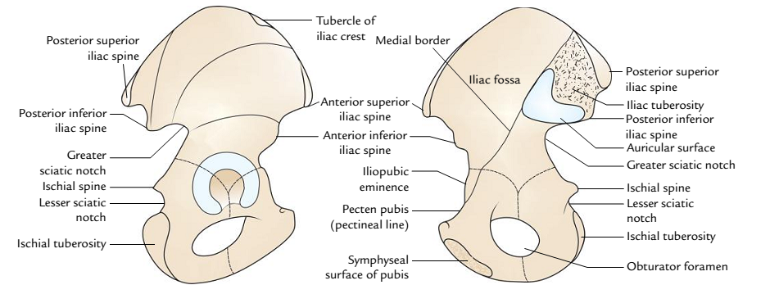
General features of the ilium: A, outer surface; B, inner surface

Slide 11
Intermediate area: It provides origin to the internal oblique muscle along its whole extent.
Inner lip
(i) Its anterior two-third provides attachment to transversus abdominis muscle.
(ii) Its posterior one-third provides attachment to quadratus lumborum.

Slide 12
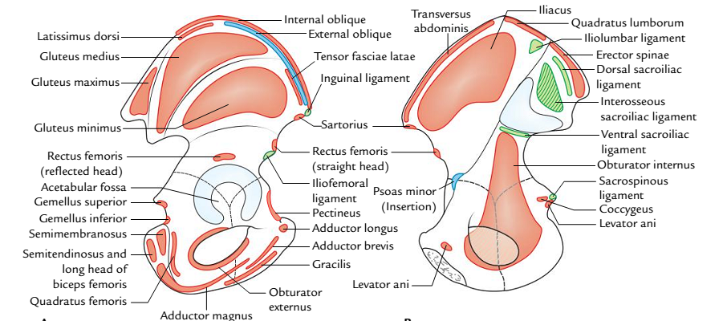
Special features (attachments) of the ilium: A, outer surface; B, inner surface.

Slide 13
Cont’d
Dorsal segment is divided by a ridge into inner and outer sloping surfaces:
Outer sloping surface gives origin to gluteus maximus muscle.
Inner sloping surface gives origin to erector spinae muscle.

Slide 14
Cont’d
Lower end
The lower end of ilium forms the upper two-fifth of acetabulum.
Borders of the Ilium
Anterior border
It extends from the anterior superior iliac spine to the acetabulum.
Its upper half forms a notch and its lower half projects forward as the anterior inferior iliac spine, which provides attachment to the straight head of rectus femoris in the upper

Slide 15
Cont’d
part and iliofemoral ligament in the lower part.
Posterior border
It extends from the posterior superior iliac spine to the upper end of the posterior border of ischium.
It presents from above downward, posterior inferior iliac spine, greater sciatic notch, ischial spine, and lesser sciatic notch.

Slide 16
Cont’d
The greater and lesser sciatic notches are converted into greater and lesser sciatic foramina by the sacrospinous and sacrotuberous ligaments.
The dorsal aspect of ischial spine is crossed from lateral to medial side by three structures:
Pudendal nerve.
Internal pudendal vessels.
Nerve to obturator internus.

Slide 17
Cont’d
Medial border
It extends downward, forward, and medially from the iliac crest to the iliopubic eminence.
It separates the iliac fossa from the sacropelvic surface.
Lower one-third of the medial border forms a rounded arcuate line.

Slide 18
Surfaces of the Ilium
Iliac fossa
It is a shallow concave surface on the inner aspect of ilium, below the iliac crest, and in front of the medial border.
Iliacus muscle arises from its upper two-third.
Gluteal surface
It is the outer aspect of the ilium which is convex in front and concave behind.
It is divided into four areas by three gluteal lines: posterior, anterior, and inferior.

Slide 19
Cont’d
All these lines radiate from the upper margin of the greater sciatic notch. The posterior gluteal line meets the dorsal segment of the iliac crest, anterior gluteal line meets the iliac crest close to the tubercle of the iliac crest, and inferior gluteal line meets the upper end of anterior inferior iliac spine.

Slide 20
Cont’d
The gluteal surface provides origin to four muscles:
Gluteus maximus, behind the posterior gluteal line.
Gluteus medius, between the anterior and the posterior gluteal lines.
Gluteus minimus, between the anterior and the inferior gluteal lines.
Reflected head of rectus femoris, between the inferior gluteal line and upper margin of acetabulum.

Slide 21
Sacropelvic surface
It is situated behind the medial border, on the inner side of ilium. It is divided into two parts-sacral part, dorsally and pelvic part, ventrally.
Sacral part of the sacropelvic surface
The sacral part presents the tuberosity of the ilium behind and the auricular surface in front.
The iliac tuberosity is a rough area below the dorsal part of iliac crest and provides attachment to three ligaments.

Slide 22
Cont’d
(a) iliolumbar, (b) dorsal sacroiliac, and (c) interosseous sacroiliac.
The auricular surface is an ear-shaped articular surface and articulates with the corresponding surface of the sacrum to form a sacroiliac joint.
Pelvic part of the sacropelvic surface
It is smooth and continuous with the pelvic surface of the ischium to form the lateral wall of lesser pelvis.
It presents pre-auricular sulcus just in front of auricular surface, along the lateral border of greater sciatic notch.
Most of this surface provides origin to obturator internus.

Slide 23
Ischium
It is the thick posteroinferior part of hip bone and consists of a body and a ramus.
Body
It is very thick and lies below and posterior to the acetabulum.
It presents two ends-upper and lower; three borders-anterior, posterior, and lateral; and three surfaces-femoral, dorsal, and pelvic.

Slide 24
Cont’d
Ends
Upper end: It forms posteroinferior two-fifth of the acetabulum, where it unites with the ilium and pubis.
Lower end
It forms the ischial tuberosity and gives off ramus which forms an acute angle with body.
Ischial tuberosity is rough and divided by a horizontal ridge into an upper quadrilateral area and lower triangular area.

Slide 25
Cont’d
The upper quadrilateral area is subdivided by an oblique ridge into upper lateral and lower medial parts.
The lower triangular area is subdivided by a longitudinal ridge into outer and inner parts.
The ischial tuberosity provides origin to four muscles:
Semimembranosus arises from the lateral part of the upper quadrilateral area.
Semitendinosus along with long head of biceps femoris arises from the medial part of the upper quadrilateral area.

Slide 26
Cont’d
Adductor magnus (ischial head), arises from the outer part of lower triangular area.
The inner part of the lower triangular area is covered by fibrofatty tissue and transmits the body weight in sitting position.
Medial margin of the ischial tuberosity is sharp and provides attachment to the lower end of sacrotuberous ligament.

Slide 27
Cont’d
Borders
Anterior border: It forms the posterior margin of the obturator foramen and gives attachment to the obturator membrane.
Posterior border
It is continuous above with the posterior border of ilium and ends below the upper end of ischial tuberosity.
It presents a triangular projection called ischial spine.

Slide 28
Cont’d
The tip of spine provides attachment to the sacrospinous ligament, and levator ani and coccygeus muscles arise from its pelvic surface.
Ischial spine forms the lower boundaries of greater sciatic notch and lesser sciatic notch.
The gemellus superior and gemellus inferior muscles arise from the upper and lower ends of the lesser sciatic notch, respectively.

Slide 29
Cont’d
Lateral border
It forms the lateral margin of the ischial tuberosity.
Its upper part is notched close to the lower margin of the acetabulum and lodges the tendon of obturator externus.

Slide 30
Cont’d
Surfaces
Femoral surface
It is directed forward and laterally, and is situated between the anterior and lateral borders.
Obturator externus arises from this surface along the obturator foramen.
Quadratus femoris arises from this surface along the lateral border of the ischial tuberosity.

Slide 31
Cont’d
Dorsal surface
It is continuous above with the gluteal surface of ilium.
It is divided by a transverse groove into the upper and lower parts.
Tendon of obturator internus along with two gemelli traverse through the groove between the upper and lower parts.
Pelvic surface
It is smooth and lies between the anterior and posterior borders. It gives origin to the obturator internus.

Slide 32
Cont’d
Ramus of the Ischium
It arises from the lower part of the body and runs upward, forward, and medially, and meets with the inferior ramus pubis to form conjoint ischiopubic ramus.
Conjoint ischiopubic ramus
The conjoint ischiopubic ramus presents two borders, upper and lower, and two surfaces-outer and inner.
Upper border forms the lower margin of obturator foramen and provides attachment to the obturator membrane.

Slide 33
Cont’d
Lower border
It forms the lateral boundary of the subpubic angle.
It is everted. The eversion is more marked in males than females due to attachment of crus of penis.
Outer surface is concave and provides linear attachment to four muscles. From above downward these are: (a) Obturator externus, (b) Adductor magnus, (c) Adductor brevis, (d) Gracilis.

Slide 34
Cont’d
Inner surface is convex and subdivided by the upper and lower oblique bony ridges into three areas-upper, middle, and lower.
Upper ridge provides attachment to the superior fascia of urogenital diaphragm.
Lower ridge provides attachment to the perineal membrane (inferior fascia of urogenital diaphragm) and falciform process of sacrotuberous ligament.
Upper area provides origin to the obturator
internus.

Slide 35
Cont’d
Middle area provides attachments to the sphincter urethrae and deep transversus perinei muscles.
Lower area provides attachments from before backward to crus of penis, clitoris, ischiocavernosus, and superficial transversus perinei muscles.

Slide 36
Pubis (Pubic Bone)
It is the anteroinferior part of the hip bone and consists of three parts-body, superior ramus, and inferior ramus.
Body
It is quadrilateral in outline and flattened anteroposteriorly.
It presents the following features: pubic crest, pubic tubercle, and three surfaces (anterior, posterior, and medial).
Pubic crest and pubic tubercle
The pubic crest is the thickened upper border of the body of pubis and its lateral end projects forward to form tubercle called pubic tubercle.

Slide 37
Cont’d
Surfaces
Anterior surface
It is directed downward, forward, and laterally.
It provides attachments to the following four muscles:
Adductor longus arises by a rounded tendon from the angle between the pubic crest and pubic symphysis.
Gracilis arises from its lower part and extends further on the ischiopubic ramus.

Slide 38
Cont’d
Adductor brevis arises lateral to gracilis and extends further on the ischiopubic ramus.
Obturator externus arises from this surface adjacent to the obturator foramen.
Posterior surface
It is smooth and forms the anterior wall of bony pelvis, hence also called pelvic surface.
It is directed upward and backward, and is related to the urinary bladder.

Slide 39
Cont’d
Medial surface (symphyseal surface): It articulates with the medial surface of the opposite pubic bone to form secondary cartilaginous joint called symphysis pubis.
Superior Ramus of Pubis
It arises from the superolateral angle of the body of pubis and extends laterally above the obturator foramen and ends at iliopubic eminence where it unites with the ilium. It is triangular in cross section and presents three borders-posterior (pectineal line), anterior (obturator crest), and inferior; and three surfaces-pectineal, pelvic, and obturator.

Slide 40
Cont’d
Borders
Pectineal line (posterior border)
It is also called pecten pubis.
It extends laterally as a sharp line from the pubic tubercle to the posterior part of iliopubic eminence where it becomes continuous with arcuate line.
Pectineal line provides attachment to a large number of structures:
Medial part from before backward provide attachments to: Lacunar ligament, reflected part of inguinal ligament, conjoint tendon, fascia transversalis.

Slide 41
Cont’d
Lateral part from behind forward provides attachment to: pectineal ligament (ligament of Cooper), pectineus muscle, pectineus fascia, psoas minor (if present).
Obturator crest (anterior border):It extends from the pubic tubercle to the acetabular margin near the acetabular notch.
Inferior border: It forms the upper margin of obturator foramen and provides attachment to the obturator membrane leaving a gap for the obturator canal.

Slide 42
Cont’d
Surfaces
Pectineal surface
It is a triangular area between the obturator crest and the pectineal line.
It extends from the pubic tubercle to iliopubic eminence.
Pectineus muscle arises from the upper part of this surface.
Pelvic surface: It lies between the pectineal line and inferior border of the superior ramus and continues medially with the pelvic surface of the body of pubis.
It is featureless and covered by the peritoneum

Slide 43
Cont’d
Obturator surface
It is situated between the obturator crest and the inferior border.
Obturator nerve and vessels traverse the obturator groove seen on this surface.
Inferior Ramus of Pubis
It extends downward and laterally from the lower part of the body of pubis to join the ramus of ischium and form the conjoint ischiopubic ramus.

Slide 44
OBTURATOR FORAMEN
It is a large gap in the lower part of the hip bone situated between the pubis and ischium.
It is oval and larger in males and triangular and smaller in females.
Obturator membrane is attached along to its margin except where it bridges the obturator groove to convert it into obturator canal. It transmits the obturator nerves and vessels.

Slide 45
ACETABULUM
It is a large cup-shaped cavity on the outer surface of the middle constricted part of the hip bone.
It is directed laterally and slightly anteroinferiorly.
All the three parts of the hip bone contribute in its formation as follows:
Pubis forms its anterior one-fifth.
Ischium forms its posterior two-fifth.
Ilium forms its superior two-fifth.

Slide 46
Cont’d
Its margin is deficient inferiorly to form the acetabular notch, which is bridged by the transverse acetabular ligament, and the notch is converted into acetabular foramen.
The acetabulum receives the head of femur to form the hip joint.
The fibrocartilaginous rim, the acetabular labrum, is attached to the margins of the acetabulum.

Slide 47
Cont’d
The acetabulum presents a horseshoe-shaped articular surface, the lunate surface, in its periphery and nonarticular area in its central part, the acetabular fossa.
The acetabular fossa is filled with the pad of fat and the lunate surface is covered by a plate of hyaline cartilage.

Slide 48
Differences between the male and female hip bones
Features | Female | Male
Greater sciatic notch | Wider (75°) | Narrower (< 50°)
Ischial spine | Not inverted | Inverted
Ischiopubic ramus | Thin and not everted | Thick and everted
Obturator foramen | Triangular | Oval
Acetabular diameter | Less than 5 cm | More than 5 cm
Distance between the pubic tubercle and anterior acetabular margin | Less than transverse diameter of acetabulum | Equal to the transverse diameter of acetabulum
Pre-auricular sulcus | More conspicuous | Less conspicuous
Iliac fossa | Shallower | Deeper

Slide 49
Ossification of the hip bone
Centres | Age of appearance | Age of fusion
Primary centres •1 for ilium •1 for ischium •1 for pubis | 2nd month of IUL 3rd month of IUL 4th month of IUL | 18th year
Secondary centres •2 for iliac crest •2 for Y-shaped acetabular cartilage •1 for ischial tuberosity | Puberty | 20–25 years (except acetabular cartilage which ossifies at the age of 17 years)

Slide 50
THANK YOU ALL, FOR LISTENING.

Slide 51
FEMUR
The femur is the longest and strongest bone of the body, present in the thigh. It is about 18 inches (45 cm long), i.e., about one-fourth of the height of the individual. At the upper end, it articulates with the hip bone to form the hip joint, and at the lower end, it articulates with the patella and tibia. The femur transmits body weight from the hip bone to the tibia in standing position.

Slide 52
PARTS
The femur is the long bone and consists of three parts: upper end, shaft, and lower end.
The upper end consists of the head, neck, and greater and lesser trochanter.
The shaft of the femur is gently convex anteriorly with maximum convexity in the middle third where the shaft is narrowest.
The lower end of the femur is enlarged to form medial and lateral condyles. Both condyles project backward and are separated by the intercondylar fossa.

Slide 53
Cont’d
The most prominent points on the condyles are called epicondyles.

Slide 54
Cont’d
Angle of inclination of femur: It is an angle between the long axes of neck and shaft of the femur hence also called neck–shaft angle. The normal neck–shaft angle is 125° in adults and 160° in children.
Angle of femoral torsion: It is an angle between long axis of the head and neck of femur, and transverse axis of the femoral condyles. It measures about 7° in males and 12° in females.

Slide 55
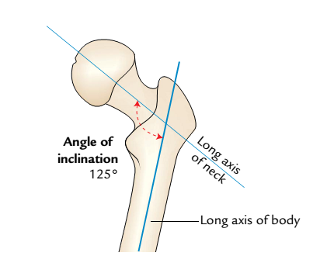
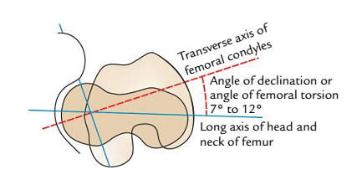
Angle of the femoral torsion (angle of declination of the femur)
Angle of inclination of the femur

Slide 56
FEATURES AND ATTACHMENTS
Upper End
Head
It forms about two-third of a sphere and articulates with the acetabulum of the hip bone to form the hip joint.
It presents a small pit, the fovea, just below and behind the centre, which provides attachment to the ligament of the head of femur (ligamentum teres femoris).

Slide 57
Cont’d
Neck
It is 5 cm long and connects the head with the shaft.
It is directed upward, medially, and slightly forward.
The angle between its lower border and the medial border of shaft is called neck-shaft angle.
The neck presents two borders-upper and lower, and two surfaces-anterior and posterior.

Slide 58
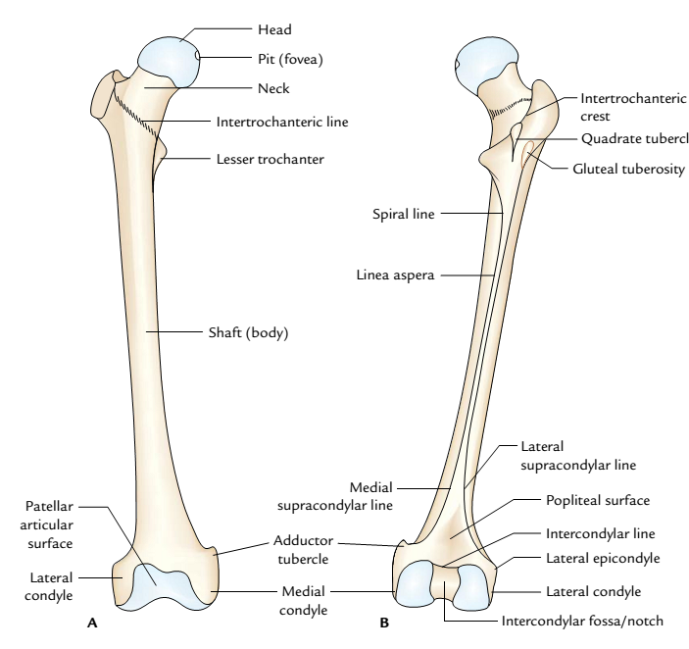
General features of the femur: A, anterior view; B, posterior view

Slide 59
Cont’d
Upper border
It is concave and horizontal.
It meets the shaft near the greater trochanter.
Lower border
It is straight and oblique.
It meets the shaft near the lesser trochanter.
Anterior surface
It is flat and bears a number of oblique bony ridges.
It meets the shaft at intertrochanteric line.
It is completely intracapsular

Slide 60
Cont’d
Intertrochanteric line
It continues downward and medially below the lesser trochanter on the posterior aspect of femur as spiral line.
It provides attachment to two ligaments and two muscles:
Capsule of the hip joint.
Iliofemoral ligament (strongest ligament in the body).
Vastus lateralis to its upper end.
Vastus medialis to its lower end.

Slide 61
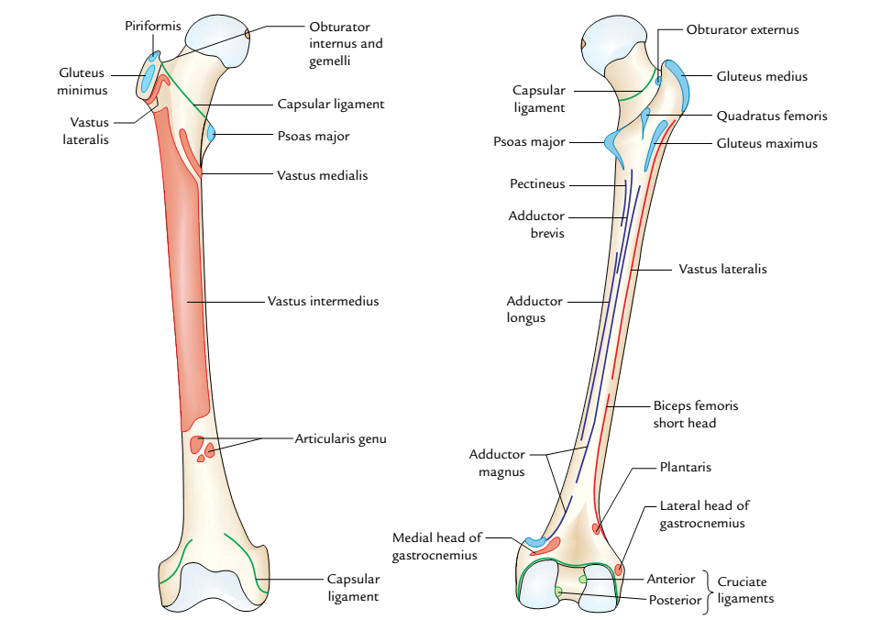
Special features (attachments) of the femur: A, anterior view; B, posterior view

Slide 62
Cont’d
Posterior surface
It is convex from above downward and concave from side-to-side.
It meets the shaft at intertrochanteric crest.
Its medial half is intracapsular.
It presents a faint groove, which lodges the tendon of obturator externus.

Slide 63
Cont’d
Intertrochanteric crest
It extends from the posterosuperior angle of greater trochanter to the tip of lesser trochanter.
It presents a rounded tubercle near the middle called quadrate tubercle, which provides insertion to the quadratus femoris.
Greater Trochanter
It is a quadrilateral elevation, projecting upward from the lateral aspect of the junction of neck and shaft.
It presents one border (upper) and three surfaces (anterior, medial, and lateral).

Slide 64
Cont’d
Upper border
Its posterior part presents the apex or tip of greater trochanter, which provides attachment to the piriformis.
Anterior surface
It provides attachment to the gluteus minimus on a ridge in its lateral part. Its medial part is related to a synovial bursa-trochanteric bursa of gluteus minimus.

Slide 65
Cont’d
Medial surface
It presents two depressions:
A depression (trochanteric fossa) at its junction with the neck for insertion of obturator externus.
A shallow depression above and in front of trochanteric fossa for insertion of obturator internus along with the gemellus superior and gemellus inferior.

Slide 66
Cont’d
Lateral surface
It is quadrilateral and divided diagonally by an oblique ridge into the upper and lower triangular areas.
The ridge provides attachment to the gluteus medius muscle.
The triangular areas-anterior and posterior to the ridge are related to the trochanteric bursae of the gluteus medius and gluteus maximus, respectively.

Slide 67
Cont’d
Lesser Trochanter
It is a conical projection arising from the posteromedial surface of the neck-shaft angle. It is directed medially.
Its apex provides attachment to the psoas major.
Iliacus is attached to its base on the front.

Slide 68
Cont’d
Shaft
Features
Basically the shaft of femur presents three surfaces—anterior, medial, and lateral and three borders—medial, lateral, and posterior.
The middle third of posterior border is represented by a thick ridge called linea aspera, which acts as a buttress to resist the compressive forces and prevents the anterior bowing of the shaft. The linea aspera presents inner and outer lips and an intervening intermediate area

Slide 69
Cont’d
When the upper end of linea aspera is traced upward, its inner and outer lips diverge and enclose a triangular posterior surface in the upper one-third of the shaft. The inner (medial) lip becomes continuous with the spiral line and the outer (lateral) lip becomes continuous with the gluteal tuberosity, which extends up to the root of greater trochanter.
When the lower end of linea aspera is traced downward, its inner and outer lips, diverge below, and enclose a triangular popliteal surface in the lower one-third of the shaft. The inner (medial) lip becomes continuous with the medial supracondylar line, which ends at the adductor tubercle.

Slide 70
Cont’d
The outer (lateral) lip becomes continuous with lateral supracondylar line. Thus, the shaft presents five surfaces-anterior, medial, lateral, upper posterior, and lower posterior (popliteal surface).

Slide 71
Attachments
The shaft of femur provides attachment to the following muscles and intermuscular septa:
Attachments of intermuscular septa:
Medial intermuscular septum is attached to the medial lip of linea aspera.
Lateral intermuscular septum is attached to the lateral lip of the linea aspera.
Muscular attachments:
Vastus intermedius arises from the upper three-fourth of anterior surface and adjoining lateral surface.

Slide 72
Cont’d
Articularis genu arises by few small slips from the lower one-fourth of anterior surface immediately below the vastus intermedius.
Vastus lateralis arises in a linear fashion from the upper part of intertrochanteric line, anterior and inferior borders of greater trochanter, lateral margin of gluteal tuberosity, and lateral lip of linea aspera.

Slide 73
Cont’d
Vastus medialis arises in a linear fashion from the lower part of intertrochanteric line, spiral line, and the medial lip of linea aspera and the upper one fourth of medial supracondylar line.
Gluteus maximus is inserted into the gluteal tuberosity.
Adductor longus is inserted into the medial lip of linea aspera.
Pectineus is inserted into a line extending from the lesser trochanter to the upper end of linea aspera.

Slide 74
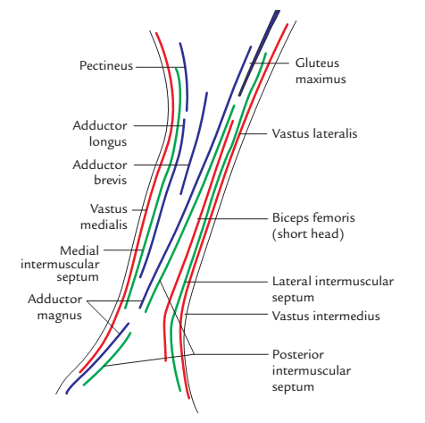
Structures attached to the linea aspera

Slide 75
Cont’d
Adductor brevis is inserted into a line extending from the lesser trochanter to the upper part of linea aspera.
Adductor magnus is inserted into the medial margin of gluteal tuberosity, linea aspera, medial supracondylar line, and adductor tubercle.
Gastrocnemius: The medial head arises from the popliteal surface just above the medial condyle. The lateral head arises mainly from the lateral condyle but also extends over the lower end of lateral supracondylar line.
Plantaris arises from the lower end of lateral supracondylar line just above the lateral head of gastrocnemius.

Slide 76
Cont’d
Lower End
Medial Condyle
Its most prominent point is called medial epicondyle, which provides attachment to the upper end of medial collateral ligament. A projection posterosuperior to the medial epicondyle is called adductor tubercle, which provides insertion to the ischial head of adductor magnus.
Its lateral surface forms medial boundary of intercondylar fossa.

Slide 77
Cont’d
Lateral Condyle
It is stouter and stronger than the medial condyle but less prominent.
Its lateral surface presents a prominence called lateral epicondyle which provides attachment to the fibular collateral ligament of the knee joint.
Smooth impression above and behind the lateral epicondyle gives origin to the lateral head of gastrocnemius.
A groove below and behind the lateral epicondyle provides attachment to popliteus in its anterior part. Tendon of popliteus occupies the posterior part of this groove during full flexion at the knee joint.

Slide 78
Cont’d
Its medial surface forms the lateral boundary of intercondylar fossa.
Intercondylar Fossa (Intercondylar Notch)
It is a deep notch, which separates two condyles posteriorly.
It is limited posteriorly above by intercondylar line.
It presents medial and lateral walls and floor.
Medial wall of the fossa provides attachments to the upper end of posterior cruciate ligament in its anteroinferior part.
Lateral wall of the fossa provides attachment to the upper end of anterior cruciate ligament in its posterosuperior part.

Slide 79
Cont’d
Articular Surface
The lower end of femur presents a V-shaped articular surface occupying the anterior, inferior, and posterior surfaces of both condyles.
The apex of ‘V’ is called patellar surface which occupies the anterior surfaces of two condyles and articulates with the patella.
The two links of ‘V’ form tibial surfaces which occupy the inferior and posterior surfaces of two condyles to come in contact with corresponding articular surfaces of tibial condyles.

Slide 80
OSSIFICATION
The femur ossifies from five centres: one primary and four secondary centres. The primary centre appears in the midshaft. Three secondary centres appear in the upper end and one secondary centre in the lower end.

Slide 81
Ossification of the femur
Centres | Time of appearance | Time of fusion
Primary centre In mid shaft | 7th to 8th week of IUL
Secondary centres 1 for head 1 for greater trochanter 1 for lesser trochanter | 1 year 3 years 13 years | Three separate epiphysis 18th year
For lower end 1 | 9 months (at the time of birth) | 20 years

Slide 82
APPLIED ANATOMY
Fracture neck of femur: It is very common in elderly particularly in women due to osteoporotic changes in the neck.
Types of fracture: The fracture may be intracapsular (subcapital, transverse cervical) or extracapsular (basal, intertrochanteric, and subtrochanteric). In intracapsular fracture, the retinacular vessels-the chief source of blood supply to the head-are injured. This leads to delayed healing or non-union of fracture, or even avascular necrosis of the head of femur.

Slide 83
Cont’d
In intracapsular fracture of the neck of femur, the affected limb is shortened and characteristically held in laterally rotated position with the toes pointing laterally.
Medicolegal significance of ossification centre at the lower end of femur: The secondary centre at the lower end of femur is unique in the sense that it appears during birth/just before birth (ninth month of IUL). It is of medicolegal importance because its appearance in radiograph indicates maturity of the fetus.

Slide 84
PATELLA
The patella is the largest sesamoid bone, found in the tendon of quadriceps femoris. It is situated in front of the knee joint, hence it is also called knee cap.
It is a flattened and triangular bone with the base facing upward, and the apex downward. Its anterior aspect is convex and rough, whereas its posterior surface presents a large articular surface divided into small medial part and large lateral part.

Slide 85
ANATOMICAL POSITION AND SIDE DETERMINATION
Hold the patella in such a way that:
Its apex faces downward and its base faces upward.
Its articular surface faces posteriorly. The large lateral part of articular surface determines the side.

Slide 86
FEATURES AND ATTACHMENTS
The patella presents the following features:
Apex.
Three borders: Superior, medial, and lateral.
Two surfaces: Anterior and posterior.
Apex
It is directed downward and provides attachment to the ligamentum patellae, which connects the patella to the tibial tubercle.

Slide 87
Cont’d
Borders
Superior border (also called base)
It provides attachment to rectus femoris in the anterior part and vastus intermedius in its posterior part.
Lateral border
It provides attachment to vastus lateralis in its upper one-third and lateral patellar retinaculum in the lower two-third.

Slide 88
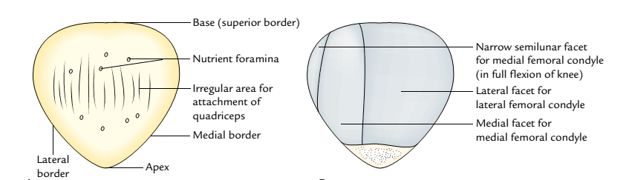
General features of the right patella: A, anterior aspect; B, posterior aspect.

Slide 89
Cont’d
Medial border
It provides attachment to vastus medialis in the upper two-third and medial patellar retinaculum in its lower one-third.
The lateral and medial patellar retinaculum are the expansions of the tendons of vastus lateralis and vastus medialis, respectively.

Slide 90
Cont’d
Surfaces
Anterior surface
It is rough, convex, longitudinally striated, and presents numerous vascular foramina.
It is subcutaneous and subcutaneous prepatellar bursa intervenes between it and skin.

Slide 91
Cont’d
Posterior surface
Its lower one-fourth is rough and non-articular, while its upper three-fourth is smooth and articular.
Small non-articular part near the apex is divided into two areas: lower and upper.
Lower area provides attachment to ligamentum patellae.
Upper area is related to infrapatellar pad of fat.

Slide 92
Cont’d
The large articular area is primarily divided by a vertical ridge into a larger lateral and a smaller medial area in order to fit with the reciprocal articular surfaces of the femur. The vertical ridge itself occupies the groove on the patellar surface of femoral lower end in the position of extension.
Larger lateral articular area lies in contact with the lateral femoral condyle in all positions of the knee.
Small medial articular area is further divided by another vertical ridge into a large lateral part and a narrow medial part called medial strip.

Slide 93
Cont’d
The medial strip comes in contact with the under surface of medial femoral condyle during full flexion at the knee.
Leaving aside this medial strip, whole of articular surface of the patella is subdivided into upper, middle, and lower areas by two faint horizontal lines.

Slide 94
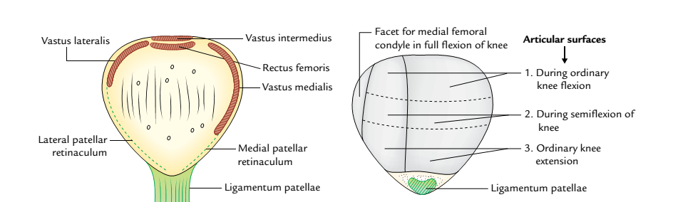
Special features of the right patella: A, anterior aspect; B, posterior aspect.

Slide 95
OSSIFICATION
The patella ossifies from several centres which appear during 3-6 years and fuse quickly to form a single centre. The ossification of patella is completed at puberty.

Slide 96
APPLIED ANATOMY
Dislocation of the patella: The patella has natural tendency to dislocate laterally due to upward and lateral pull by the quadriceps. However, it is countered by three factors.
More forward projection of lateral femoral condyle.
More prolonged insertion of vastus medialis to the medial border of the patella than that of vastus lateralis on the lateral border.
Medial pull exerted by medial patellar retinaculum.

Slide 97
Cont’d
Fracture of the patella:
(a) A direct blow on the patella fractures it into two or more pieces, and (b) a sudden and forceful contraction of quadriceps femoris causes a transverse fracture of the patella. The patella being a sesamoid bone is devoid of the periosteum, hence when fractured bony union does not take place.

Slide 98
Cont’d
Abnormal ossification of the patella. Abnormal ossification centres in the patella may form two or three separate pieces of the patella (called bipartite or tripartite patella). This condition can be differentiated from fracture of the patella as it is bilateral and the pieces have smooth margins.

Slide 99
TIBIA
The tibia is the second largest bone in the body situated on the medial side in the leg. The tibia is the pre-axial bone and homologous with the lateral bone of the forearm, the radius. It transmits weight of the body from femur to the foot.
PARTS
It is a long bone and consists of three parts: upper end, lower end, and intervening shaft.

Slide 100
Cont’d
The upper end is expanded and bears prominent medial and lateral condyles and tibial tuberosity. The medial condyle is larger than the lateral condyle. The two condyles articulate with the condyle of the femur.
The shaft has three borders-anterior, medial, and lateral; and three surfaces-medial, lateral, and posterior. The anterior border is the sharpest and takes a sinuous course from the tibial tuberosity and becomes continuous below with the anterior border of the medial malleolus.

Slide 101
Cont’d
The lower end is small and projects medially and inferiorly as medial malleolus.

Slide 102
ANATOMICAL POSITION AND SIDE DETERMINATION
The side of tibia is determined by holding the bone vertically in such a way that:
Its expanded end with condyles faces upward.
Its tibial tuberosity and sharp sinuous anterior border of the shaft faces anteriorly.
Medial malleolus is on the medial side.
Superior surface of the upper end (tibial plateau) lies in a horizontal plane.

Slide 103
FEATURES AND ATTACHMENTS
Upper End
It presents two condyles (medial and lateral), an intercondylar area and tibial tuberosity.
Medial Condyle
It is larger than the lateral condyle and presents four surfaces: superior, posterior, anterior, and medial.

Slide 104
Cont’d
Superior surface
It has a smooth oval articular surface which articulates with the femoral condyle.
It is slightly concave in the centre and flattened at the periphery. The peripheral flattened part is covered by fibrocartilaginous plate, the medial meniscus.
Posterior surface
It presents a deep transverse groove for the insertion of tendon of semimembranosus.

Slide 105
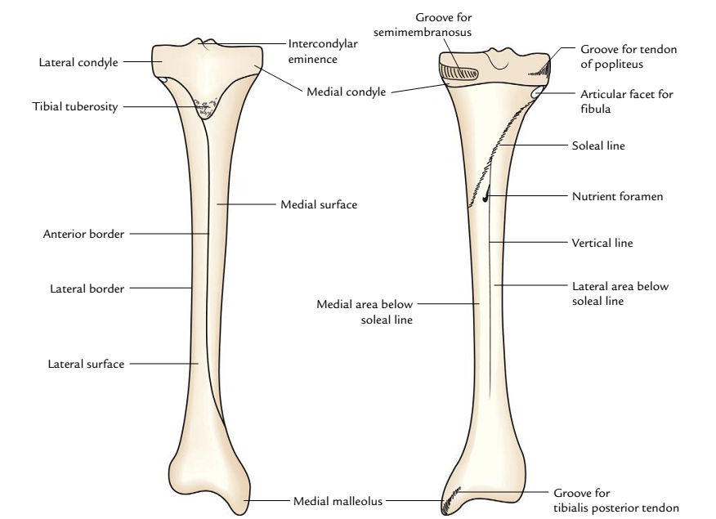
Cont’d
General features of the tibia: A, anterior view; B, posterior view

Slide 106
Cont’d
Anterior and medial surfaces
The anterior and medial surfaces are marked by the vascular foramina and adjoining margin provides attachment to the medial patellar retinaculum.
Lateral Condyle
Like medial condyle the lateral condyle also presents four surfaces:
Superior surface
It presents a circular articular surface for articulation with the lateral femoral condyle.

Slide 107
Cont’d
It is slightly concave in the centre and flattened at the periphery. The flattened peripheral part is covered by a plate of fibrocartilage-the lateral meniscus.
Posterior surface
Inferolaterally, this surface presents a circular smooth articular facet for the head of fibula.
Between the articular facet for the fibula and the margin of superior surface there is a shallow groove for the tendon of popliteus.

Slide 108
Cont’d
Anterior and lateral surfaces
The anterior surface has a flat triangular facet for the attachment of the iliotibial tract.
Anterior and lateral surfaces provide attachment to the lateral patellar retinaculum.

Slide 109
Cont’d
Intercondylar Area
It is the rough area on the superior surface of the upper end of tibia between the articular surfaces of two condyles.
The middle of intercondylar area is narrow and marked by an elevation called intercondylar eminence. The medial and lateral parts of the eminence are more prominent and constitute the medial and lateral intercondylar tubercles.

Slide 110
Cont’d
From before backward, the intercondylar area provides attachments to six structures.
Anterior horn of Medial meniscus.
Anterior Cruciate ligament.
Anterior horn of Lateral meniscus.
Posterior horn of Lateral meniscus.
Posterior horn of Medial meniscus.
Posterior Cruciate ligament.

Slide 111
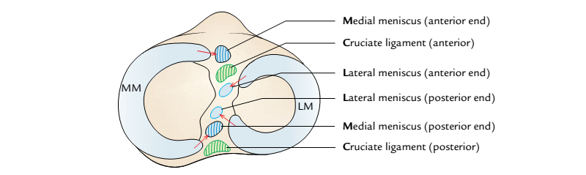
Structures attached in intercondylar area on the superior aspect of the tibia
(MM = medial meniscus, LM = lateral meniscus).

Slide 112
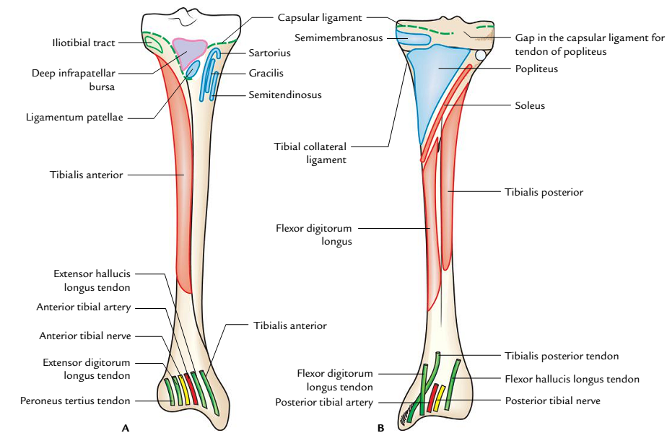
Special features (attachment) of the tibia: A, anterior aspect; B, posterior aspect

Slide 113
Cont’d
Tibial Tuberosity
It is a projection at the apex of rough triangular area located on the anterior aspect upper end of the tibia.
It is divided into an upper smooth and a lower rough part.
Upper smooth part provides attachment to the ligamentum patellae.
Lower rough part is related to the subcutaneous infrapatellar bursa which separates it from the skin.
Rough triangular area above the tuberosity is related to the deep infrapatellar bursa.

Slide 114
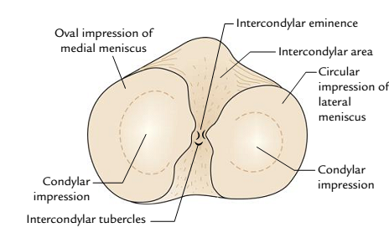
Features on the upper aspect of the tibia

Slide 115
Cont’d
Shaft
It presents three borders-anterior, medial, and lateral; and three surfaces-lateral, medial, and posterior.
Borders
Anterior border (shin of the tibia)
It is the sharpest, subcutaneous, and sinuous in course.
It extends from the tibial tuberosity to the anterior border of medial malleolus.

Slide 116
Medial border
It extends from the medial condyle to the posterior border of medial malleolus.
The soleal line joins the medial border at the junction of its upper one-third with the lower two-third.
Lateral (interosseous) border
It is sharp and extends from the lateral condyle below the facet for the head of fibula to the anterior border of fibular notch.
It provides attachment to the interosseous membrane which unites the tibia and fibula.
Its distal part divides to enclose a triangular notch for the attachment of interosseous inferior tibiofibular ligament.

Slide 117
Surfaces
Medial surface
It faces anteromedially and lies between the anterior and medial borders.
It is almost entirely subcutaneous.
Its upper part close to the medial border receives insertions of three muscles. From before backward, these are: sartorius, gracilis, and semitendinosus.
Lateral surface
It is directed anterolaterally and lies between anterior and interosseous borders

Slide 118
.Cont’d
Its upper two-third provides origin to the tibialis anterior.
Its lower one-third is crossed by the following structures from medial to lateral sides while passing from the leg to the foot:
Tibialis anterior.
Extensor hallucis longus.
Anterior tibial artery.
Deep peroneal nerve/anterior tibial nerve.
Extensor digitorum longus.
Peroneus tertius

Slide 119
Cont’d
Posterior surface
It lies between the medial and lateral borders.
A rough bony ridge extends from the fibular facet to the junction of upper and middle thirds of the medial border called soleal line. This line provides attachments to the following structures from above downward: (a) fascia covering popliteus, (b) fascia covering soleus, (c) soleus (origin), (d) deep transverse fascia.
The posterior surface of the tibial shaft is subdivided by the soleal line into an upper small triangular area and a lower large area.

Slide 120
Cont’d
A triangular area above the soleal line provides insertion to popliteus.
A large area below the soleal line is divided into a medial and a lateral part by a vertical ridge.
The nutrient foramen of the tibia is located at the upper end of this vertical ridge. Nutrient canal is directed downward. Nutrient artery is a branch of the posterior tibial artery and the largest nutrient artery of the body.
The flexor digitorum longus arises from the medial area below the soleal line.
The tibialis posterior arises from the lateral area below the soleal line.

Slide 121
Cont’d
The lower one-fourth of the posterior surface beneath the flexor retinaculum is related to the following structures from medial to lateral:
Tibialis posterior.
Flexor digitorum longus.
Posterior tibial artery.
Tibial nerve.
Flexor hallucis longus.

Slide 122
Cont’d
Lower End
The lower end presents five surfaces (anterior, posterior, medial, lateral, and inferior) and a downward projection from the medial part, the medial malleolus.
Surfaces
Anterior surface has an upper smooth and featureless part and lower rough and grooved part.
Posterior surface in its medial part presents a groove for the tendon of tibialis posterior.

Slide 123
Cont’d
Medial surface is subcutaneous and is continuous with the medial surface of the medial malleolus.
Lateral surface presents a fibular notch. Anterior and posterior margins of the fibular notch provide attachment to anterior and posterior tibiofibular ligaments. The upper part of the fibular notch is rough and provides attachments to the interosseous tibiofibular ligament.
Inferior surface is smooth and articulates with the body of the talus.

Slide 124
Cont’d
Medial Malleolus
Its tip lies at a higher level than that of the lateral malleolus and provides attachment to the deltoid ligament.
Its lateral surfaces present a comma-shaped articular facet for articulation with the similar facet on the medial surface of the body of the talus.
Its posterior surface presents a vertical groove for the tendon of tibialis posterior.
Medial margin of the groove is prominent and provides attachment to the flexor retinaculum.

Slide 125
CAPSULAR ATTACHMENTS AT THE UPPER AND LOWER ENDS OF TIBIA
At the upper end, the capsule is attached to the margins of tibial condyles medially, laterally, and posteriorly.
Anteriorly, it is attached to the sides of triangular area on the anterior aspect of condyles blending with the medial and lateral patellar retinacula and to the tibial tubercle where it blends with the ligamentum patellae.
Behind the lateral condyle, the capsule is deficient for the passage of tendon of popliteus.

Slide 126
Cont’d
At the lower end, the capsule is attached to the margins of articular surfaces where it extends on to the lower end of fibula.

Slide 127
OSSIFICATION
The tibia ossifies from three centres-one primary and two secondary.
Primary centre appears in the middle of shaft at the age of seventh week of IUL.
Secondary centres.
For the upper end:
Appearance: At birth or shortly after birth.
Fusion with the shaft: 20 years.
For the lower end:
Appearance: 2 years.
Fusion with the shaft: 18 years

Slide 128
APPLIED ANATOMY
Osteomyelitis of the upper end of tibia: The upper end of tibia is the commonest site of acute osteomyelitis, but knee joint remain unaffected because the capsule of knee joint is attached near to the margins of articular surfaces proximal to the epiphyseal line.
Fracture of tibia: The tibia is commonly fractured at the junction of upper 2/3rd and lower 1/3rd of its shaft. (The tibial shaft is narrowest at the junction of upper two-third and lower one-third, hence the commonest site of fracture).

Slide 129
Cont’d
The lower one-third of the tibial shaft is bare area (hence devoid of any muscular attachment) and have low blood supply; for this reason, the fractures in the lower 1/3rd of the shaft of tibia show delayed union or non-union.

Slide 130
FIBULA
The fibula is the lateral bone of the leg and is homologous with the ulna of forearm.
It is a long slender postaxial bone of the leg and does not take part in the transmission of the body weight.
It subserves two important functions:
It provides attachments to the muscles.
Its lower end along with the lower end of tibia forms a socket (tibiofibular mortise), to hold the talus in place.

Slide 131
PARTS
It is a long bone and consists of three parts: upper end, lower end, and intervening shaft.
The upper end (head) is round and presents a circular articular facet. An upward projection posterolateral to this facet is called styloid process.
The shaft is described to have anterior, interosseous, and posterior borders; and medial, lateral, and posterior surfaces. However, only interosseous border is clear-cut; other borders and surfaces spiral so that it is difficult to ascertain.

Slide 132
Cont’d
The lower end is flattened and bears a triangular articular facet on its medial surface for articulation with the talus.
Behind and below this is a roughened fossa called malleolar fossa

Slide 133
SIDE DETERMINATION AND ANATOMICAL POSITION
The side of fibula can be determined by holding it vertically in such a way that:
Its round end called head is directed upward.
Its relatively flattened end is directed downward.
A triangular articular facet on its lower end faces medially.
A depression at the lower end (malleolar fossa) lies behind and below the triangular articular facet at this end.

Slide 134
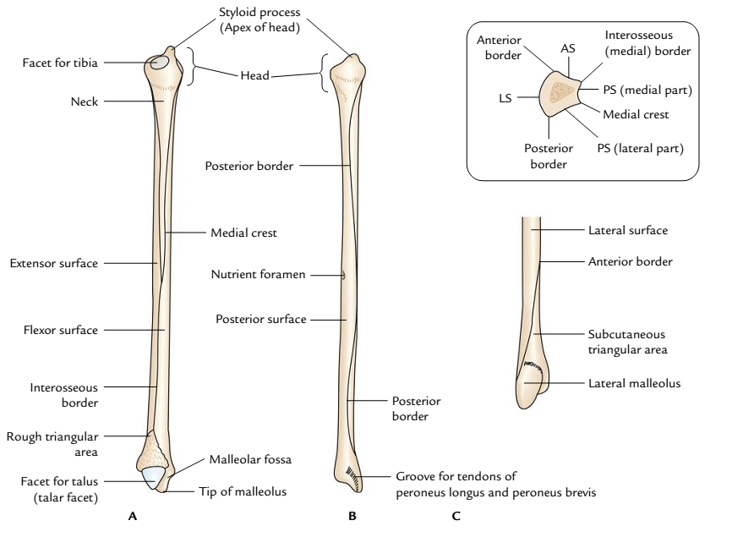
General features of the right fibula: A, medial aspect; B, posterior aspect; C, lateral aspect of lower part. Figure in the inset is the transverse section of the lower part of shaft showing borders and surfaces (AS = anterior surface, PS = posterior surface, LS = lateral surface).

Slide 135
FEATURES AND ATTACHMENTS
Upper End
It presents head and neck.
Head
It is round and presents the following three features:
An oval or circular articular facet on its superior aspect for articulation with the lateral condyle of the tibia.
A styloid process posterolateral to the articular facet which provides attachment to the fibular collateral ligament.
A sloping surface in front of the styloid process for C-shaped insertion of biceps femoris.

Slide 136
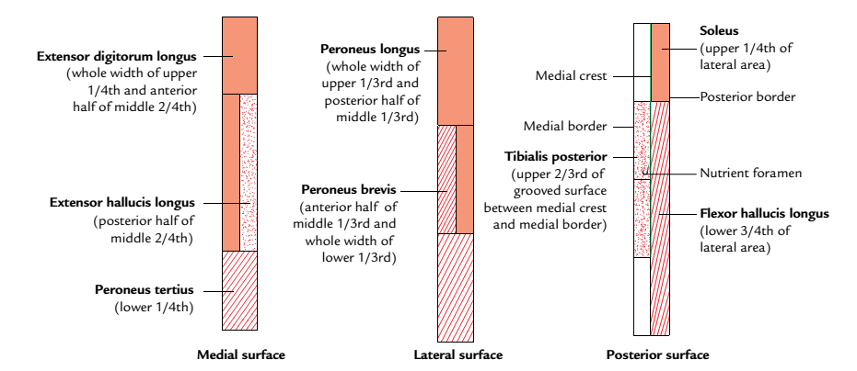
Schematic diagram to show the attachments of muscles on the different surfaces of the fibula

Slide 137
Cont’d
Neck
It is a constriction below the head, connecting it with the shaft. The common peroneal nerve is related to the posterolateral aspect of neck and anterior tibial artery on its medial aspect.

Slide 138
Cont’d
Shaft
It presents three borders-anterior, posterior, and medial; and three surfaces-medial, lateral, and posterior.
Borders
Anterior border
It provides attachment to the anterior intermuscular septum of the leg in its upper three-fourth.
It begins just below the anterior aspect of the head. Inferiorly it splits to enclose a triangular area, which continues on the lateral surface of lateral malleolus.
Superior extensor retinaculum is attached to the anterior margin of the triangular area and superior peroneal retinaculum to the posterior margin of triangular area.

Slide 139
Cont’d
Posterior border
It extends from the posterior aspect of head to the lateral margin of groove on the posterior surface of the lateral malleolus.
Posterior intermuscular septum of the leg is attached to its upper three-fourth.
Interosseous medial border
It lies close and just medial to the anterior border (separated from it only by 3 mm in the upper part).
Inferiorly it ends at the upper end of the roughened area for the interosseous ligament.

Slide 140
Cont’d
Interosseous membrane is attached along its whole length except at the upper end to leave a gap for the passage of anterior tibial vessels.

Slide 141
Cont’d
Surfaces
Medial (extensor) surface
It is narrow and lies between the anterior and interosseous borders.
It gives origin to extensor digitorum longus in upper three-fourth (whole width of its upper fourth and anterior half of its middle two-fourth).
Extensor hallucis longus arises from the posterior half of the middle two-fourth medial to the extensor digitorum longus.
Its lower one-fourth provides origin to the peroneus tertius.

Slide 142
Cont’d
Lateral (peroneal) surface
It lies between the anterior and posterior borders.
Peroneus longus arises from the upper two-third (whole width of upper one-third and the posterior half of the middle one-third).
Peroneus brevis arises from the anterior half of its middle one-third and whole width of its lower one-third.

Slide 143
Cont’d
Posterior (flexor) surface
It is extensive and lies between the interosseous and posterior borders.
Its upper two-third is divided into medial concave and flattened lateral parts by a sharp vertical ridge medial crest.
Fascia covering the tibialis posterior is attached to the medial crest.
Medial concave part gives origin to tibialis posterior.
Lateral flattened part gives origin to the soleus in upper one-fourth and to the flexor hallucis longus in lower three-fourth.

Slide 144
Cont’d
Peroneal artery descends along medial crest.
Nutrient artery, a branch of the peroneal artery, enters the nutrient foramen present just above the middle of the posterior surface. Nutrient canal is directed downward.

Slide 145
Cont’d
Lower End
The lower end of fibula is expanded anteroposteriorly to form lateral malleolus, which presents four surfaces-anterior, posterior, medial, and lateral.
Anterior surface is rough and round. It provides attachment to the anterior talofibular ligament. A notch at its lower border provides attachment to the calcaneofibular ligament.

Slide 146
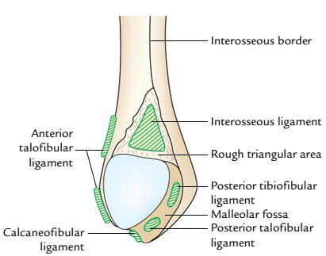
Special features of the lower end of right fibula (medial aspect).

Slide 147
Cont’d
Posterior surface presents a groove, which lodges tendons of peroneus brevis and peroneus longus, the peroneus longus being superficial to the peroneus brevis.
Medial surface presents a triangular articular surface in front and a depression (malleolar fossa) below and behind it. The upper part of malleolar fossa provides attachment to the posterior tibiofibular ligament and its lower part to the posterior talofibular ligament.
Lateral surface is triangular and subcutaneous.

Slide 148
OSSIFICATION
The fibula ossifies from three centres: one primary and two secondary.
Primary centre appears in the middle of the shaft: at the age of eighth week of IUL.
Secondary centres:
For the upper end:
Appearance:3–4 years.
Fusion with the shaft:20 years.
For the lower end:
Appearance:1–2 years.
Fusion with the shaft:18 years.

Slide 149
APPLIED ANATOMY
Bone grafts: Since the fibula does not take part in the transmission of body weight, it is a common source of bone for grafting.
Fibular fracture: The fibula is commonly fractured, 2 to 5 cm proximal to the distal end of the lateral malleolus. It is often associated with ‘fracture dislocation of the ankle joint’.

Slide 150
SKELETON OF THE FOOT
The skeleton of the foot from behind forward consists of the following bones:
Tarsals.
Metatarsals.
Phalanges.
TARSAL BONES
These are short bones which together form tarsus. These are arranged in three rows:
Proximal row consists of talus and calcaneus.
Middle row consists of navicular.
Distal row consists of three cuneiforms (medial, intermediate, and lateral) and cuboid.

Slide 151
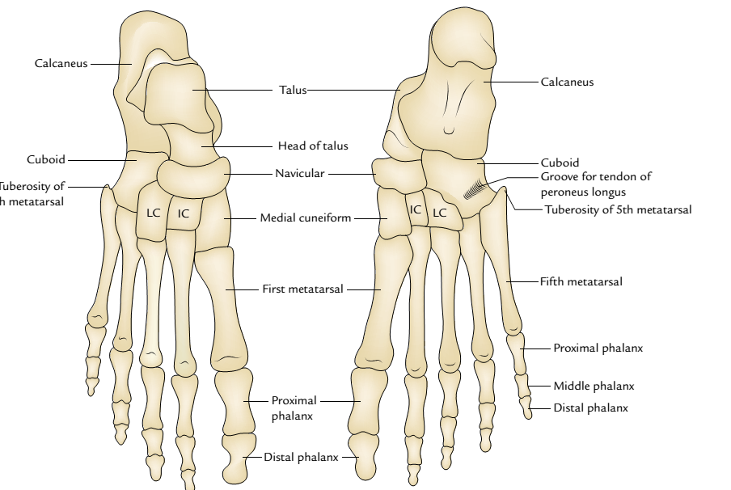
General features of the skeleton of the foot: A, dorsal aspect; B, plantar aspect
(IC = intermediate cuneiform, LC = lateral cuneiform).

Slide 152


